Slide 1
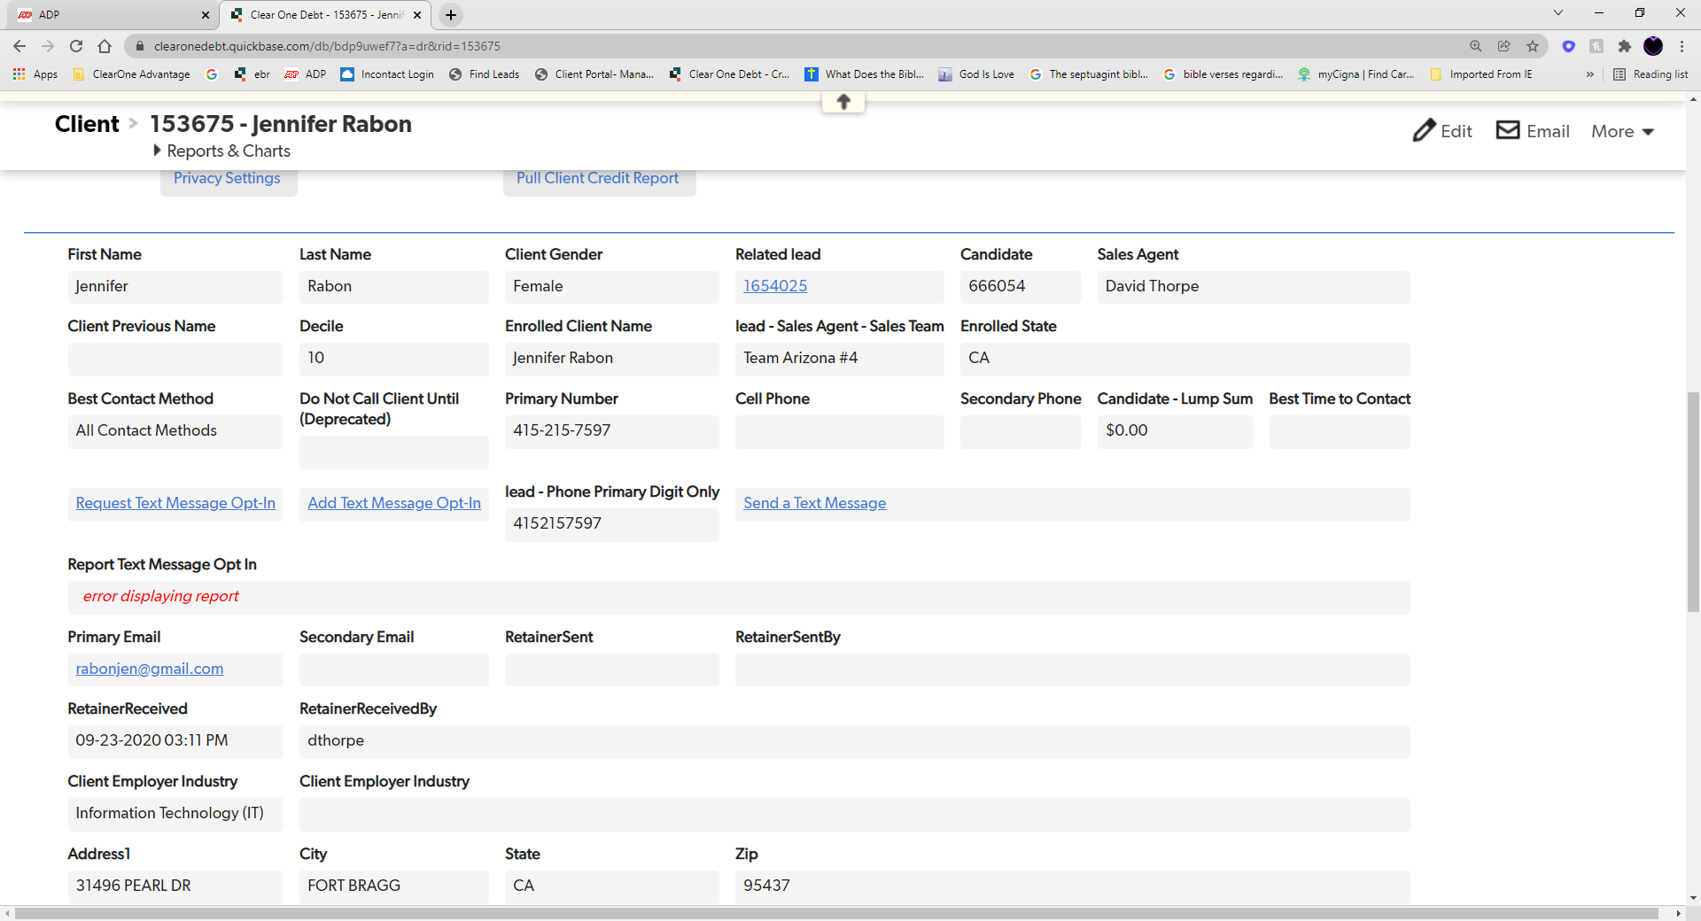

Update Contact Information
Please review the information we should be doing at the very beginning of each call to ensure that the calls with our clients continue to be successful:
Greet the client. After greeting the client, please state: “This call is being recorded for quality control and training purposes.”
Confirm the client’s address on file
After confirming the client’s address, if the phone number that the client called in on does not match the phone number on the clients account, please proceed to confirming their phone number and email address. EX: “Ms. Doe, before we proceed with any questions or concerns you may have today, may I please confirm your phone number and email address on file?”
If client needs to update any information (phone number, email address, physical address) obtain clients new information and follow the Client Sensitive Change Request SOP
Notes:
Enrollments were down to $61MM in December from $81MM in November
Internal (non-affiliate) enrollments of $46MM were 23% below forecast ($60MM)
Drivers include macro factors: holiday seasonality, covid increases, stimulus allowing customers to put off decisions
Internally we are observing it is harder to reach customers, lower P2 rates, and lower close rates

Slide 2
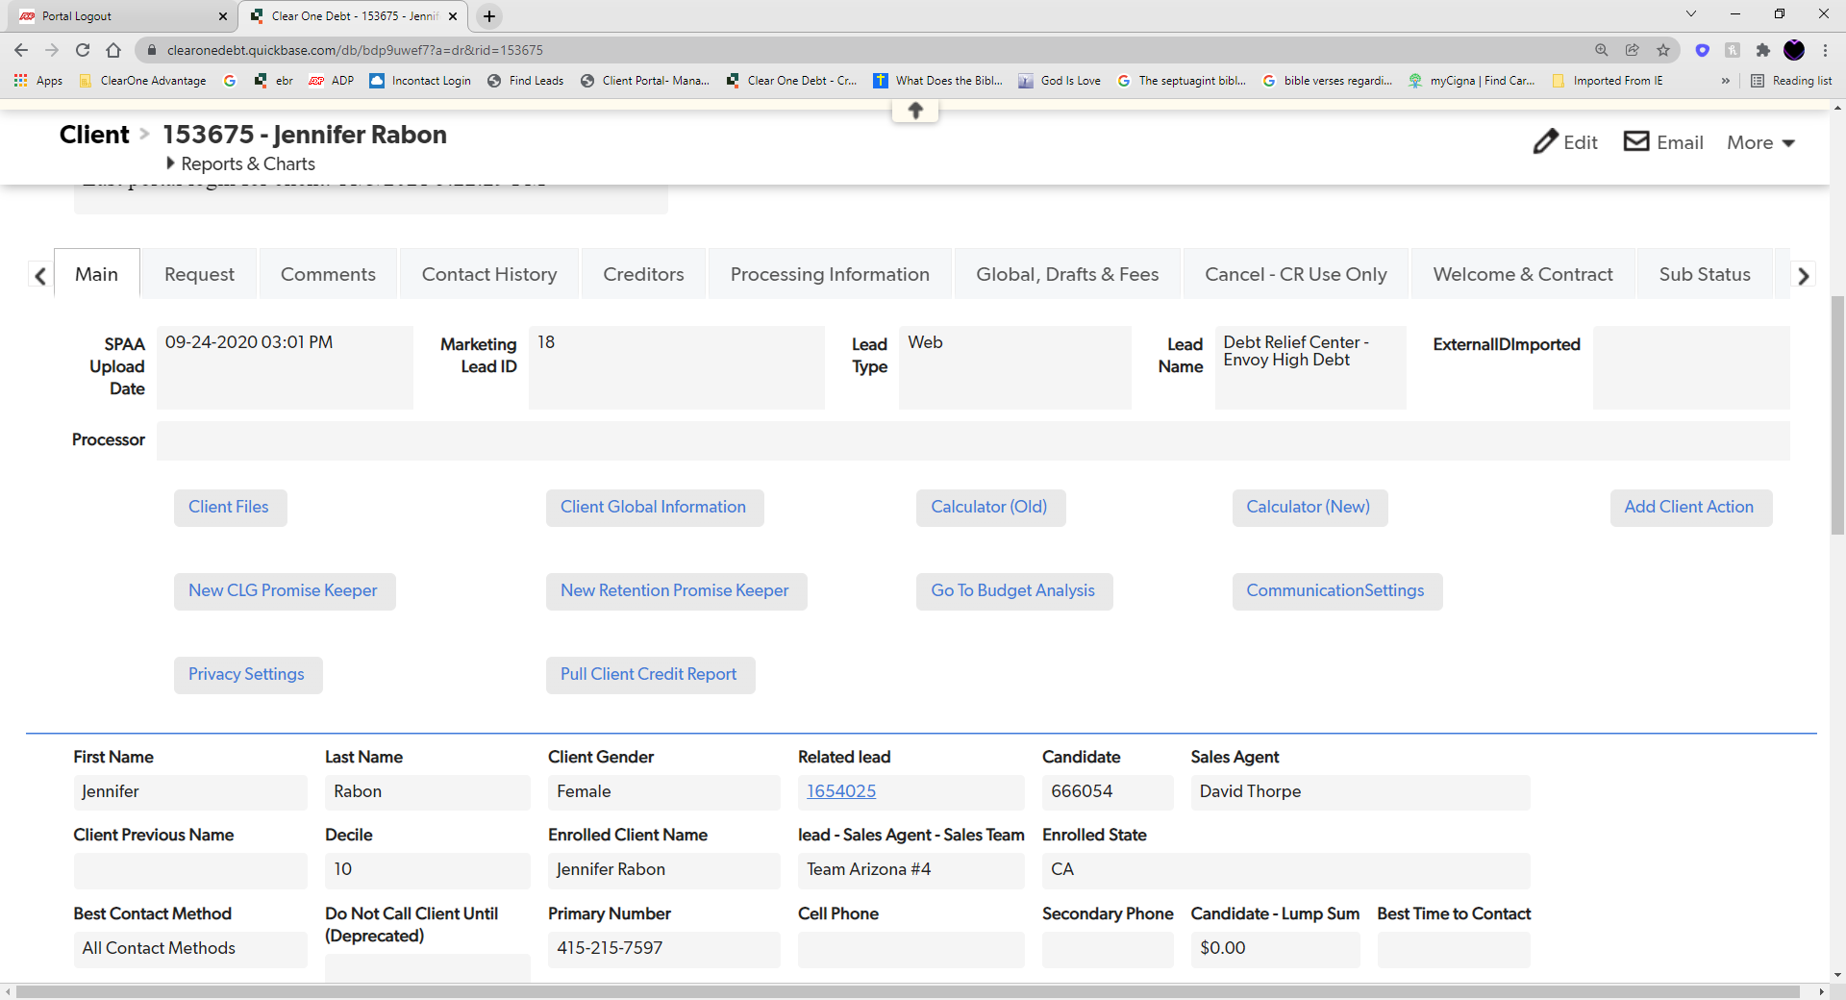



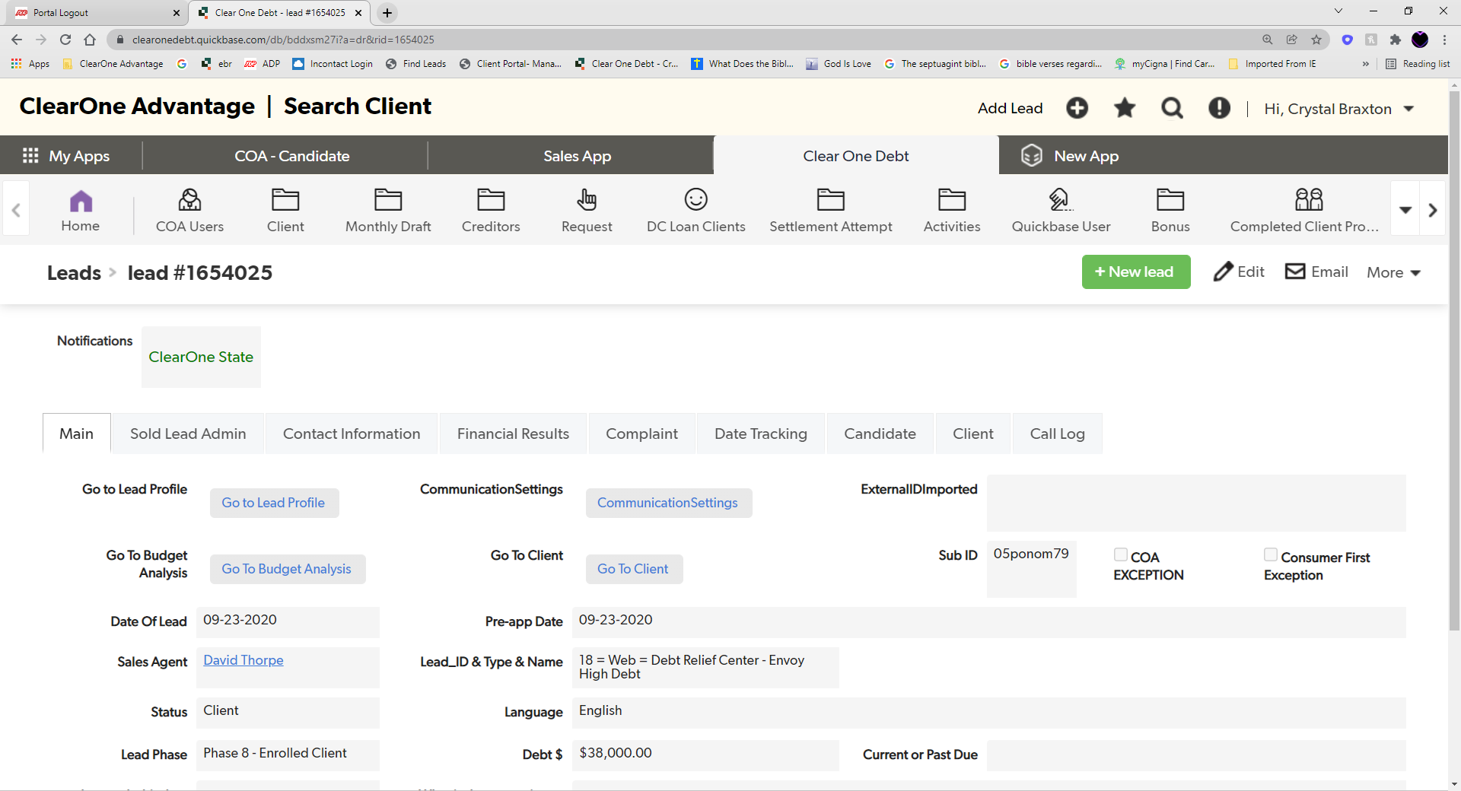

How to Update Contact Information
Please remind our clients that verbal communication is imperative while enrolled with ClearOne Advantage. The Sole Purpose is for negotiations, quicker assistance with draft changes, requests, and legal.
Step 1: Locate the “Main” tab
Step 2: Click on the “Related Lead” link on the client’s QuickBase page.
Step 3: Click on “Edit”
Step 4: Go to the “Contact Information” Tab.
Notes:
Enrollments were down to $61MM in December from $81MM in November
Internal (non-affiliate) enrollments of $46MM were 23% below forecast ($60MM)
Drivers include macro factors: holiday seasonality, covid increases, stimulus allowing customers to put off decisions
Internally we are observing it is harder to reach customers, lower P2 rates, and lower close rates

Slide 3
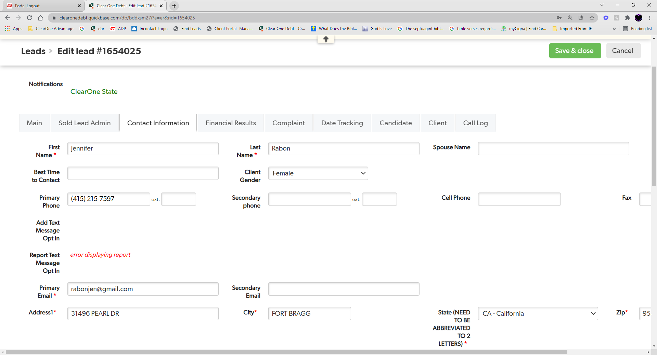




How to Update Contact Information
Step 5: Remove the current primary phone number and/or add a secondary number to the client’s account.
Step 6: You can remove the primary email address and/or add a secondary email address.
Step 7: Save & Close the Page.

